Slide 1

Project Title - Airbnb Hotel Booking Analysis
[Student Name ] – GULLAPALLI SHEETAL
[AICTE Internship ID] - STU681edf42b90491746853698

Slide 2

PROBLEM STATEMENT Airbnb Hotel Booking Analysis
The hospitality industry has undergone a significant transformation with the rise of online platforms facilitating short-term lodging and tourism. Leading this revolution is Airbnb, Inc., a pioneering American company that has reshaped travel accommodation through its innovative online marketplace. Established in 2008 in San Francisco, California, Airbnb provides a diverse range of lodging options, offering guests a unique and personalized experience. Unlike traditional hospitality providers, Airbnb operates on a commission-based model, facilitating transactions between hosts and guests without owning the properties listed on its platform.
This research analysis delves into the New York City Airbnb dataset to extract meaningful insights. Through rigorous data cleaning, exploratory analysis, and visualization techniques, the study aims to illuminate the dynamics of the city's lodging market. By discerning factors influencing listing availability, pricing strategies, and overall customer satisfaction, the research contributes to a deeper understanding of Airbnb's operations in one of the world’s most dynamic urban environments. These insights hold significance for stakeholders and enthusiasts seeking to navigate the evolving landscape of short-term accommodation.

Slide 3
Project Description
Project Description: Airbnb Hotel Booking Analysis
This project focuses on a comprehensive analysis of New York City Airbnb data to uncover trends and insights in the short-term rental market. The primary objective is to understand how various factors—such as property type, location, pricing, host characteristics, and service fees—affect listing performance and customer experience.
Objectives
Market Landscape: Identify the distribution of property types and neighborhood groups to understand supply patterns across the city.
Pricing Insights: Examine price variations among neighborhoods, property types, and construction periods to reveal pricing strategies and potential revenue opportunities.
Host Performance: Determine which hosts have the highest number of listings and assess how host verification influences guest reviews and ratings.
Cost Analysis: Explore the relationship between listing price and service fee to evaluate how additional charges impact overall cost for guests.
Data & Methodology
Dataset: The project uses the publicly available Airbnb New York City dataset (Excel/CSV format) containing details such as property type, neighborhood, price, host information, reviews, and fees.
Data Cleaning: Missing values and outliers are identified and treated to ensure accurate analysis.
Exploratory Data Analysis (EDA): Statistical summaries and visualizations (bar charts, pie charts, scatter plots, and correlation matrices) are employed to identify patterns and relationships.
Visualization Tools: Python libraries including pandas, matplotlib, and seaborn are used to create clear, interactive charts for better understanding.
Expected Outcomes
A clear picture of which neighborhoods command higher prices and which property types dominate the market.
Insight into host behavior, including the effect of verified identities on review scores.
Correlation metrics showing how price aligns with service fees and construction year.

Slide 4

WHO ARE THE END USERS?
Hosts/Owners: Set competitive prices and improve listings.
Guests/Travelers: Find the best areas and value for money.
Airbnb Management: Enhance platform features and fee policies.
Investors/Developers: Identify high-demand neighborhoods.
City Planners/Government: Guide housing and tourism policies.
Researchers/Analysts: Study market trends and predict demand.

Slide 5

Technology Used
Programming Language: Python
Libraries: pandas, numpy, matplotlib, seaborn (data cleaning, analysis, and visualization)
Data Storage: Excel/CSV dataset
Environment/Tools: Jupyter Notebook or Google Colab for development and reporting

Slide 6
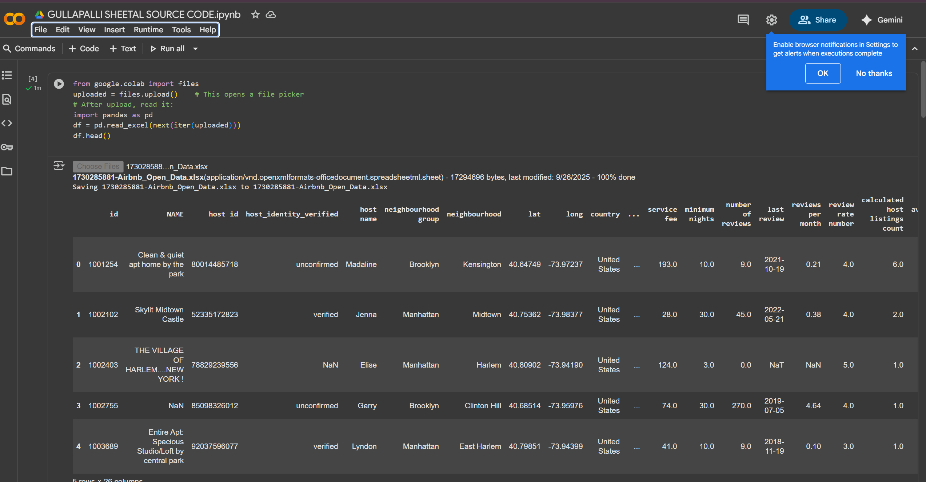
RESULTS1

Slide 7
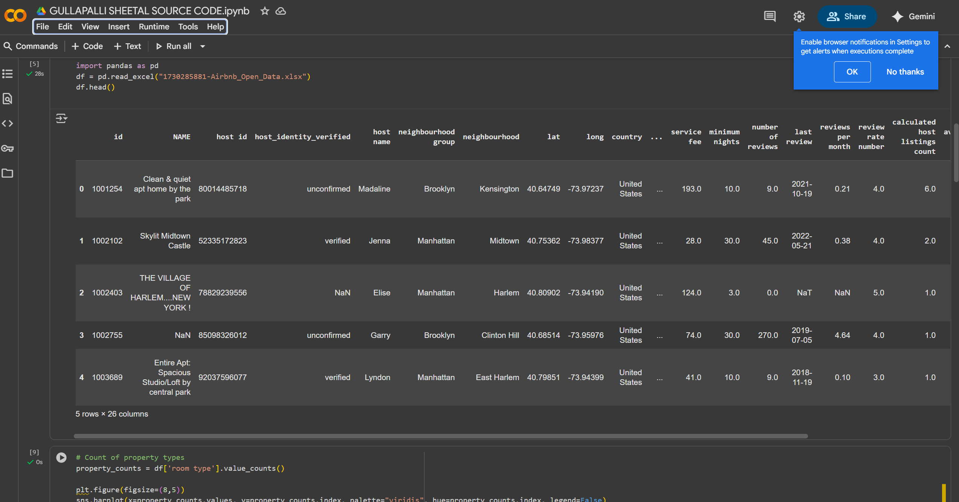
RESULTS2

Slide 8
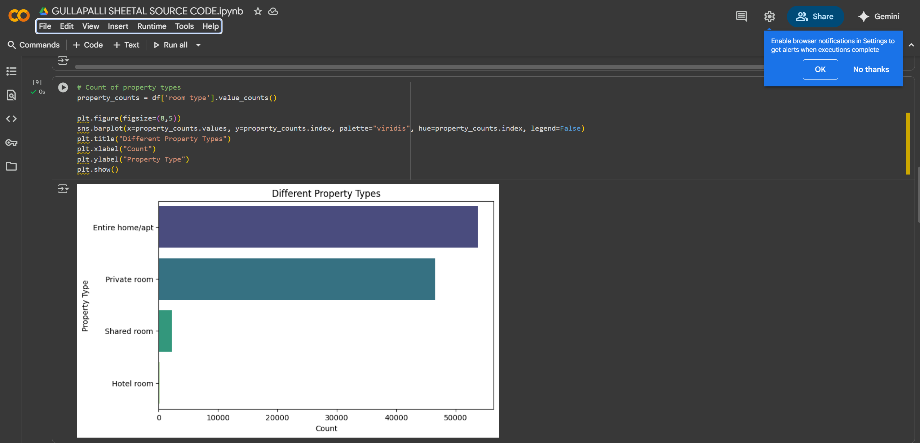
RESULTS3

Slide 9
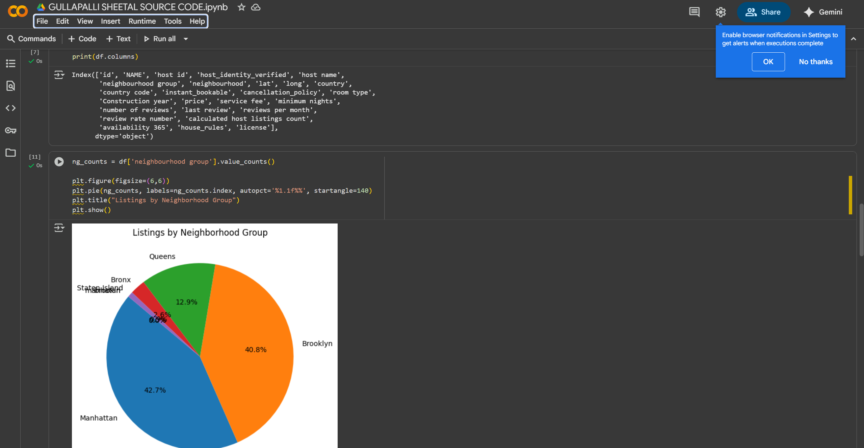
RESULTS 4

Slide 10
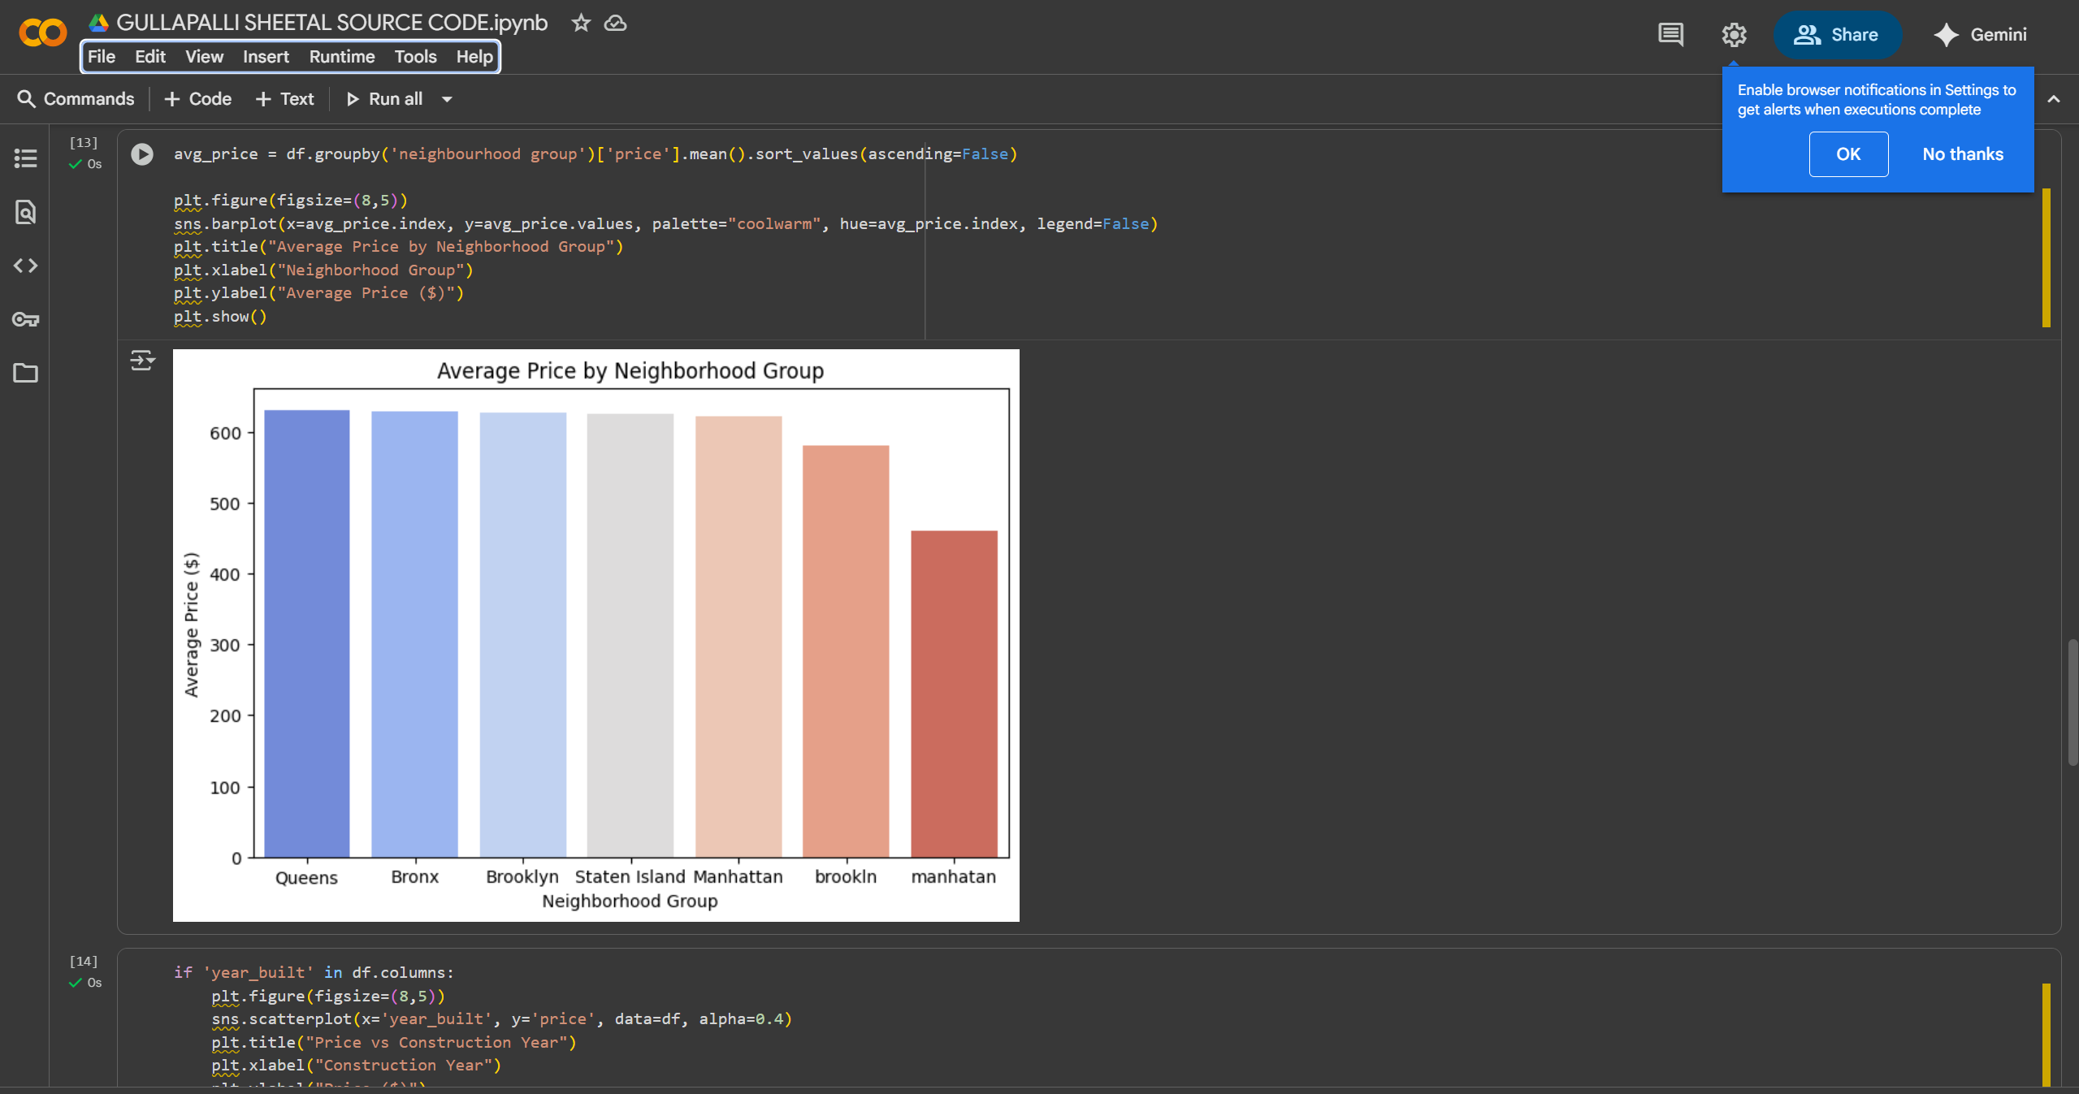
RESULTS 5

Slide 11
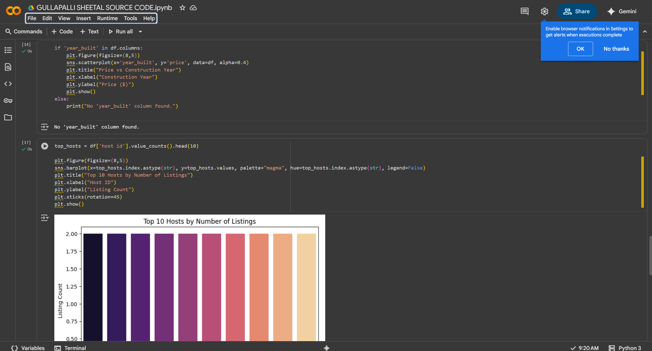
RESULTS 6

Slide 12
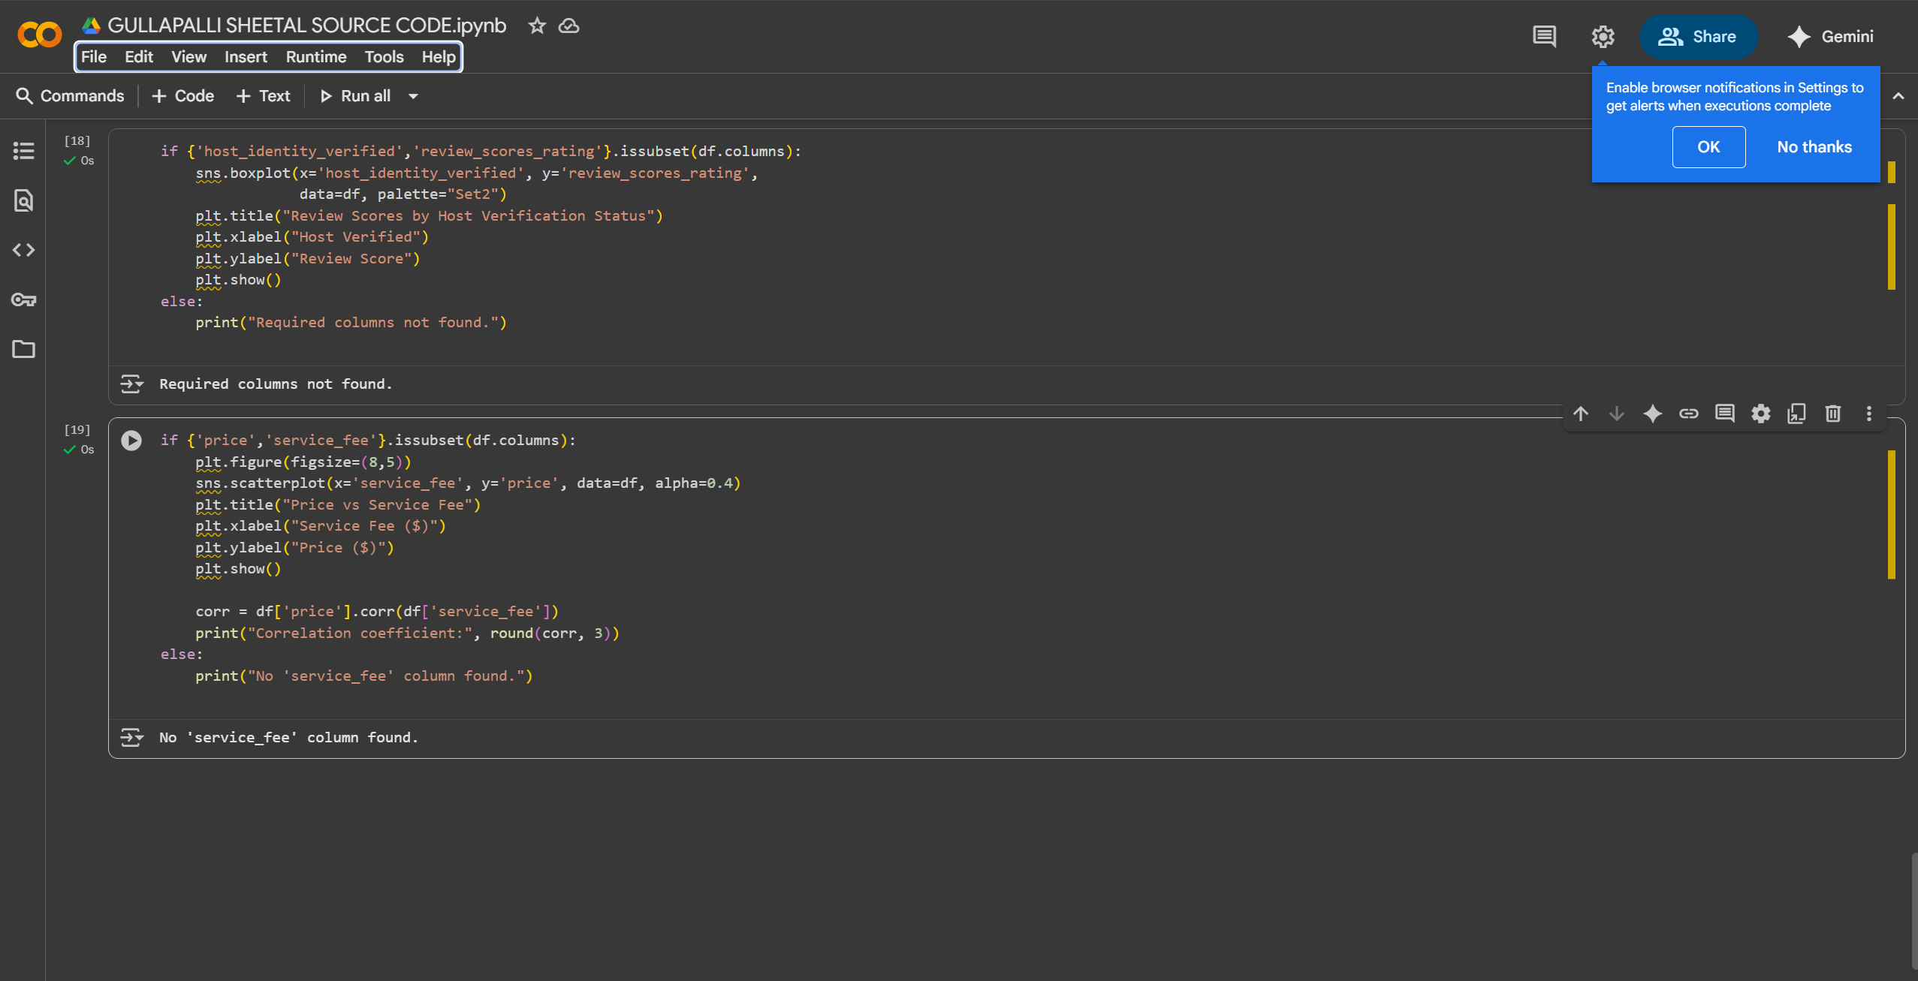
RESULTS 7

Slide 13

VIDEO LINK
https://drive.google.com/file/d/1qLf6Vwb-UIyls3djKOF-A17cfKNKFqEe/view?usp=drive_link

Slide 14
GitHub repository
https://github.com/sheetal-092/VOIS_AICTE_Oct2025_GULLAPALLI-SHEETAL

Slide 15
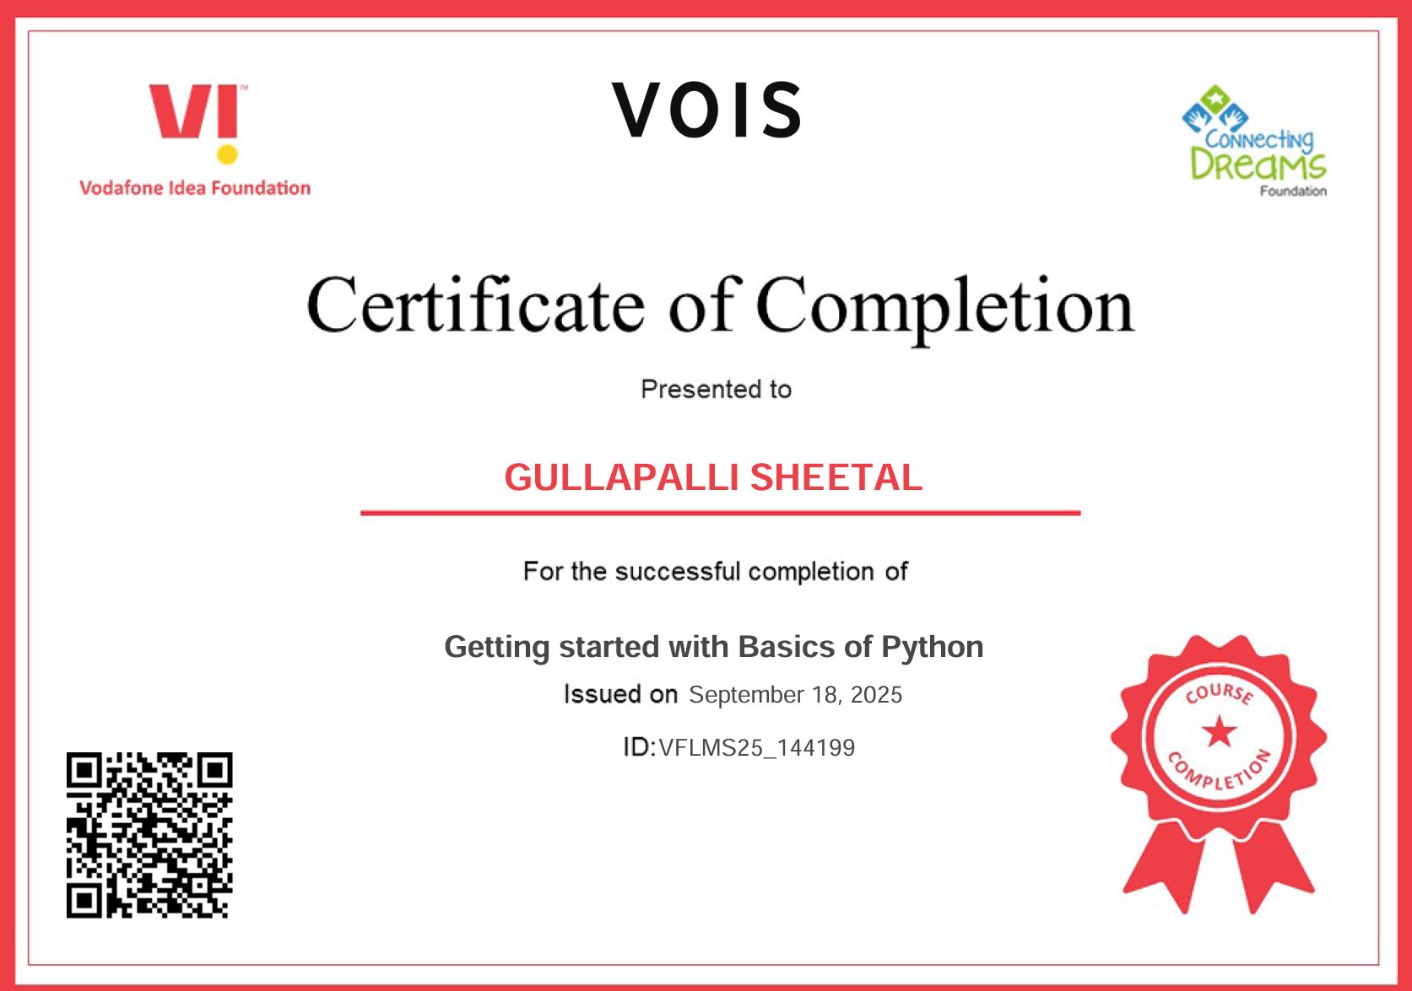
Getting started with Basics of Python Certificate

Slide 16
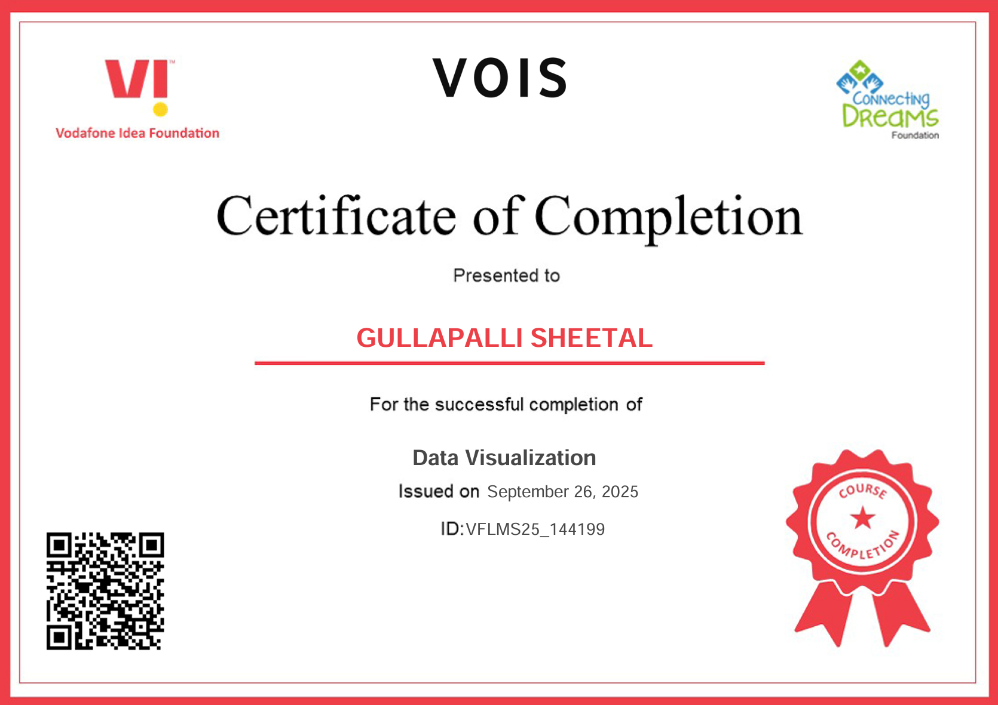
Data Visualization Certificate

Slide 17
Thank you
.
.

